Slide 2
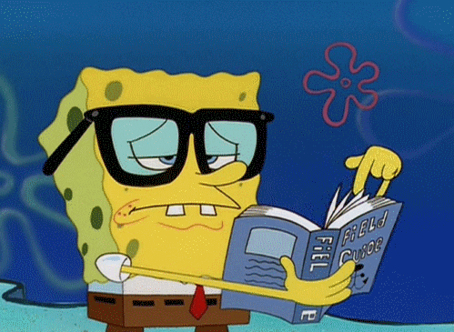
Unit
12
LIFE ON OTHER PLANETS
LESSON 1: GETTING STARTED
A Thrilling Science Fiction Novel
1

Slide 3
LESSON 1: GETTING STARTED
WARM-UP
Option 1: Brainstorming
Option 2: The one-word game
PRESENTATION
Vocabulary
Task 1: Listen and read.
Task 2: Read the conversation again and tick T (True) or F (False).
Task 3: Match the words (1 - 5) with their definitions (a - e).
Task 4: Complete the sentences with the words in 3.
PRACTICE
PRODUCTION
Task 5: Work in groups. Discuss the following questions. Then report your group’s answers to the class.
CONSOLIDATION
Wrap-up
Homework

Slide 4
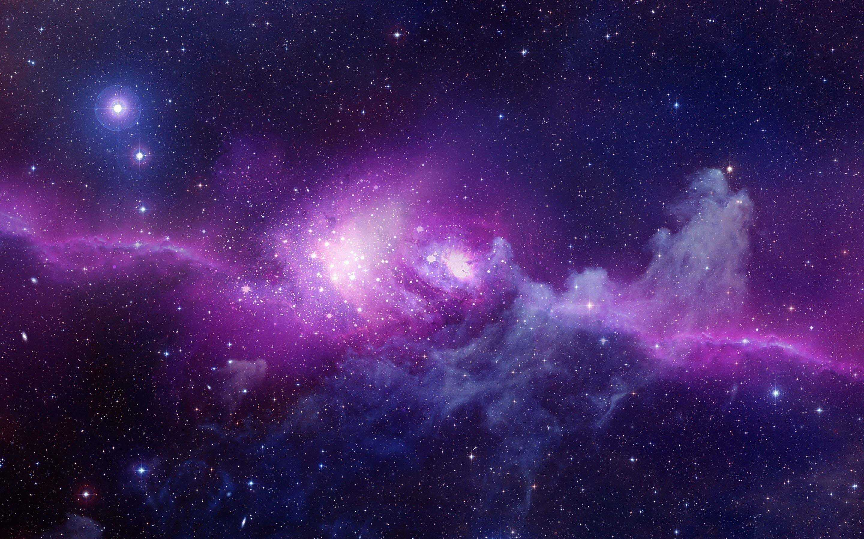
WARM-UP
OPTION 1
Write on the board the list of future technology you expect to see in the future in 2 minutes.
Science and Technology

Slide 5
WARM-UP
OPTION 1
Answer the questions:
1. Where and How fast do you think we can travel with those new technologies?
2. Can we travel to other planets with those technologies?
LIFE ON OTHER PLANETS

Slide 6
WARM-UP
OPTION 2
Answer the questions:
1. What one word would you use to describe the Earth?
The one-word game
Love, round, colorful, living, blue, beautiful....

Slide 7
WARM-UP
OPTION 2
Answer the questions:
2. What one word would you use to describe the space?
The one-word game
Enchanted, limitless, magical, immense, vast, dangerous...

Slide 8
WARM-UP
OPTION 2
Answer the questions:
3. What one word would you use to describe the alien?
The one-word game
Unreal, mysterious, exotic, friendly, threatening.

Slide 9
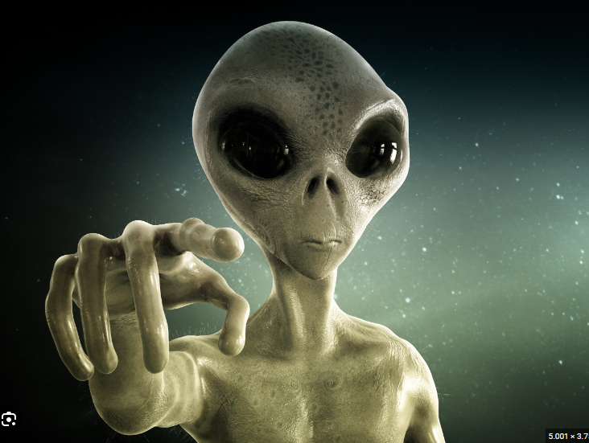
PRESENTATION
alien (n)
/ˈeɪliən/
người ngoài hành tinh

Slide 10
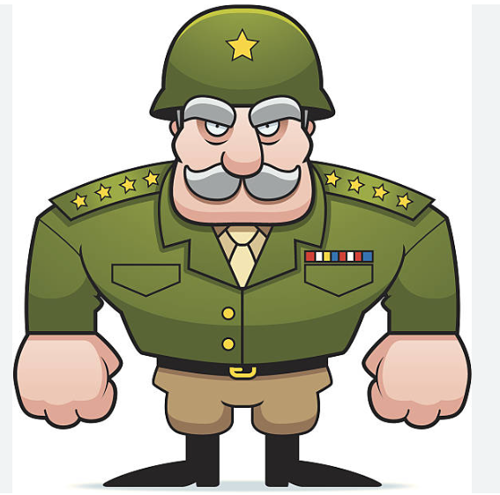
PRESENTATION
commander (n)
/kəˈmɑːndə/
người chỉ huy, người cầm đầu

Slide 11
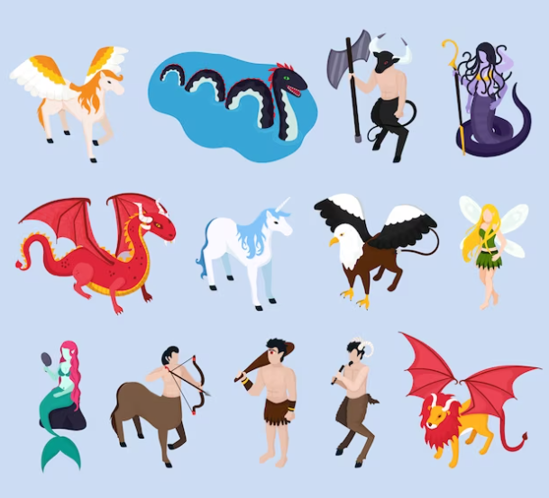
PRESENTATION
creature (n)
/ˈkriːtʃə/
sinh vật

Slide 12
PRESENTATION
destroy (v)
/dɪˈstrɔɪ/
hủy diệt/ tàn phá

Slide 13
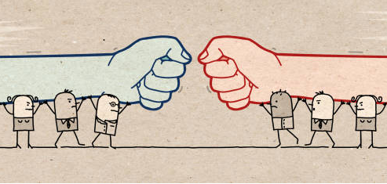
PRESENTATION
oppose (v)
/əˈpəʊz/
chiến đấu, đánh lại ai

Slide 14
PRESENTATION
spaceship (n)
/ˈspeɪsʃɪp/
phi thuyền

Slide 15
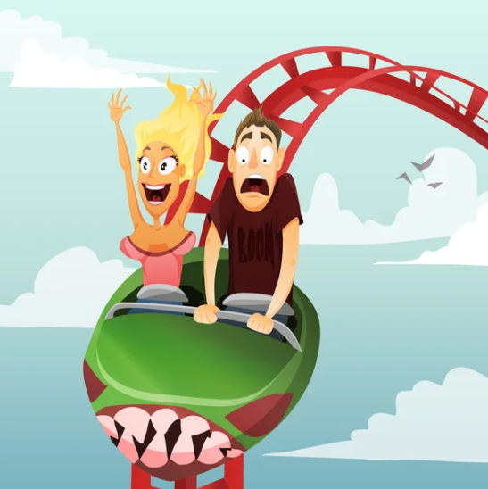
PRESENTATION
thrilling (adj)
/ˈθrɪlɪŋ/
kịch tính

Slide 16
PRESENTATION
New words | Pronunciation | Meaning
1. alien (n) | /ˈeɪliən/ | người ngoài hành tinh
2. commander (n) | /kəˈmɑːndə/ | người chỉ huy, người cầm đầu
3. creature (n) | /ˈkriːtʃə/ | sinh vật
4. destroy (v) | /dɪˈstrɔɪ/ | hủy diệt/ tàn phá
5. oppose (v) | /əˈpəʊz/ | chiến đấu, đánh lại ai
6. spaceship (n) | /ˈspeɪsʃɪp/ | phi thuyền
7. thrilling (adj) | /ˈθrɪlɪŋ/ | kịch tính

Slide 17
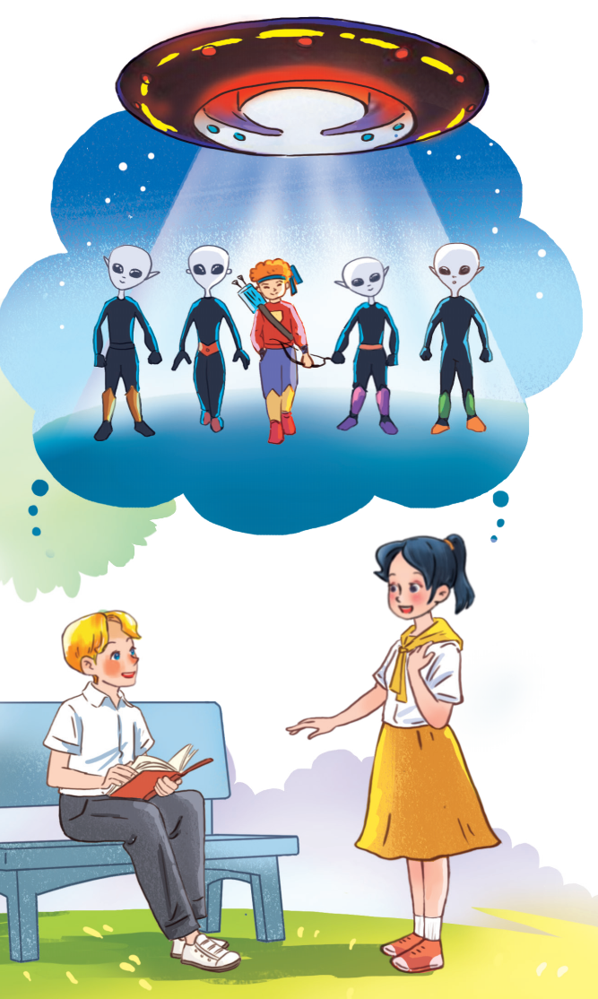
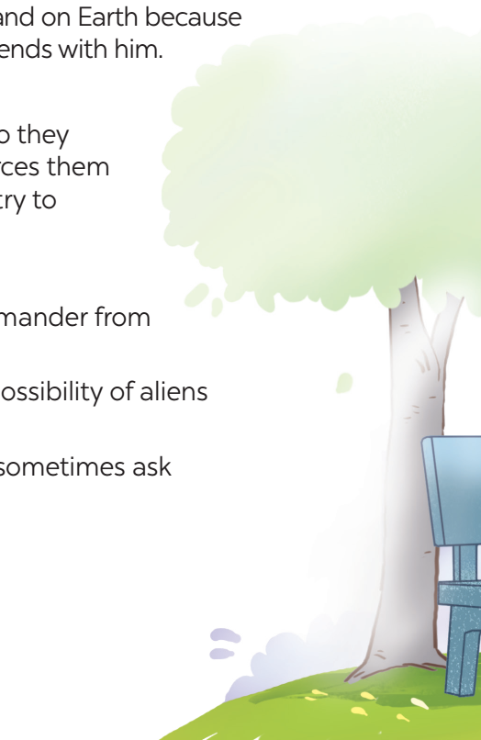
PRACTICE
What are Nick and Mai talking about?
Who do you think the men in black are?
What are Nick and Mai talking about?
Who do you think the men in black are?

Slide 18
PRACTICE
1
Listen and read.
Mai: What book are you reading, Nick? Nick: A journey back to Soduka. I’m on the last page. Mai: That’s a science fiction book, isn’t it? What’s it about? Nick: Yes, it is. It’s about four creatures Titu, Kaku, Hub, and Barb. They’re travelling back to Soduka, a planet like Earth. Along the way they have to land on Earth because their spaceship breaks down. They meet Tommy and become friends with him. Mai: What happens next? Nick: Tommy helps the four creatures repair their spaceship, so they can travel back to their home planet. But their commander forces them to return to Earth to destroy it. Tommy and the four creatures try to oppose the commander. Mai: Sounds thrilling! Nick: Tommy and the four creatures manage to stop the commander from destroying Earth. Mai: So it has a happy ending! What do you think about the possibility of aliens attacking Earth? Nick: I’m not sure about it. But I’m starting to think about it. I sometimes ask myself what we would do if aliens took over our planet.

Slide 19
PRACTICE
What are Nick and Mai talking about?
Who do you think the men in black are?
What are Nick and Mai talking about?
Who do you think the men in black are?
They are talking about aliens creatures from another planet.
They are aliens / creatures from another planet.
He is from Earth.
It is a spaceship / flying saucer / UFO.

Slide 20
PRACTICE
2
Read the conversation again and tick T (True) or F (False).
Statements | T | F
1. Soduka is a planet that is very diﬀerent from Earth.
2. Titu, Kaku, Hub, and Barb have to land on Earth because their spaceship breaks down.
3. Tommy helps the four creatures make a new spaceship so that they can return to Soduka.
4. The four creatures travel to Earth again to visit Tommy.
5. The novel makes Nick and Mai think about the possibility that Earth might be attacked by aliens.

Slide 21
PRACTICE
3
Match the words (1 - 5) with their definitions (a - e).

Slide 22
PRACTICE
4
Complete the sentences with the words in task 3.
1. There is a _________ that we might visit Mars in the near future. 2. The main character in the film is a boy who makes friends with some _____ from a planet. 3. Dogs are more social ________ than cats. 4. These soldiers were punished because they didn’t obey their __________. 5. Some people _______ sending spaceships to explore other planets.
possibility
aliens
creatures
commander
oppose

Slide 23
PRODUCTION
5
Work in groups. Discuss the following questions. Then report your group’s answers to the class.
Do you believe that there is life on other planets? Why / Why not?

Slide 24
CONSOLIDATION
1
Wrap-up
What have we learnt in this lesson?
identify the topic of the unit
use lexical items related to outer space
identify the language features that are covered in the unit

Slide 25
CONSOLIDATION
1
Wrap-up
Can you tell me some words in this lesson?

Slide 26
CONSOLIDATION
2
Homework
- Learn the new words by heart.
- Make sentences with new words.
- Start preparing for the Project of the unit.

Slide 27
Website: hoclieu.vn
Fanpage: facebook.com/tienganhglobalsuccess.vn/

